Slide 1
Osher Lifelong Learning Institute, Fall 2026
Contemporary Economic Policy
University of Massachusetts, Boston
Host: Geoffrey Woglom, Director
National Economic Education Delegation

Slide 2
National Economic Education Delegation
Vision
  One day, the public discussion of policy issues will be grounded in an accurate perception of the underlying economic principles and data.
Mission
  NEED unites the skills and knowledge of a vast network of professional economists to promote understanding of the economics of policy issues in the United States.
NEED Presentations
  Are nonpartisan and intended to reflect the consensus of the economics profession.

Slide 3
Who Are We?
Honorary Board: 54 members
  2 Fed Chairs: Janet Yellen, Ben Bernanke
  6 Chairs Council of Economic Advisers
    Furman (D), Rosen (R), Bernanke (R), Yellen (D), Tyson (D), Goolsbee (D)
  3 Nobel Prize Winners
    Akerlof, Smith, Maskin
Delegates: 652+ members
  At all levels of academia and some in government service
  All have a Ph.D. in economics
  Crowdsource slide decks
  Give presentations
Global Partners: 48 Ph.D. Economists
  Aid in slide deck development

Slide 4
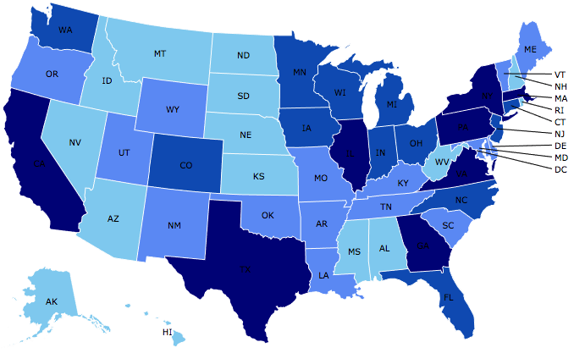
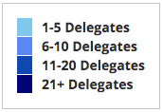
Where Are We?

Slide 5
Available NEED Topics Include:
US Economy
Healthcare Economics
Climate Change
Economic Inequality
Economic Mobility
Trade and Globalization
Minimum Wages
Immigration Economics
Housing Policy
Federal Budgets
Federal Debt
Black-White Wealth Gap
Autonomous Vehicles
US Social Policy

Slide 6
Course Schedule
Contemporary Economic Policy
  Week 1 (9/16): Economic Update & Changes at the Fed, Geoffrey Woglom, Amherst College
  Week 2 (9/23): Economic Inequality, Joseph Carolan, Oakland University
  Week 3 (9/30): Saving Social Security, Geoffrey Woglom, Amherst College
  Week 4 (10/07): Federal Debt, Dmitriy Stolyarov, University of Michigan
  Week 5 (10/14): Trade and Globalization, Andreas Waldkirch, Colby College
  Week 6 (10/21): Climate Change Economics, Sarah Jacobson, Williams College

Slide 7
Submitting Questions
I encourage questions. Please put questions in the chat and I will answer them periodically during the talk,
We will do a verbal Q&A once the material has been presented.
Slides are available from the NEED website https://needecon.org/delivered_presentations.php.

Slide 8
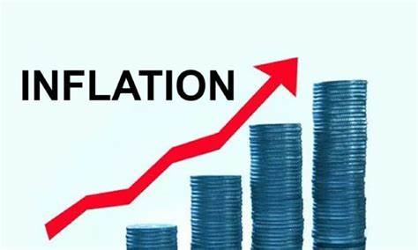
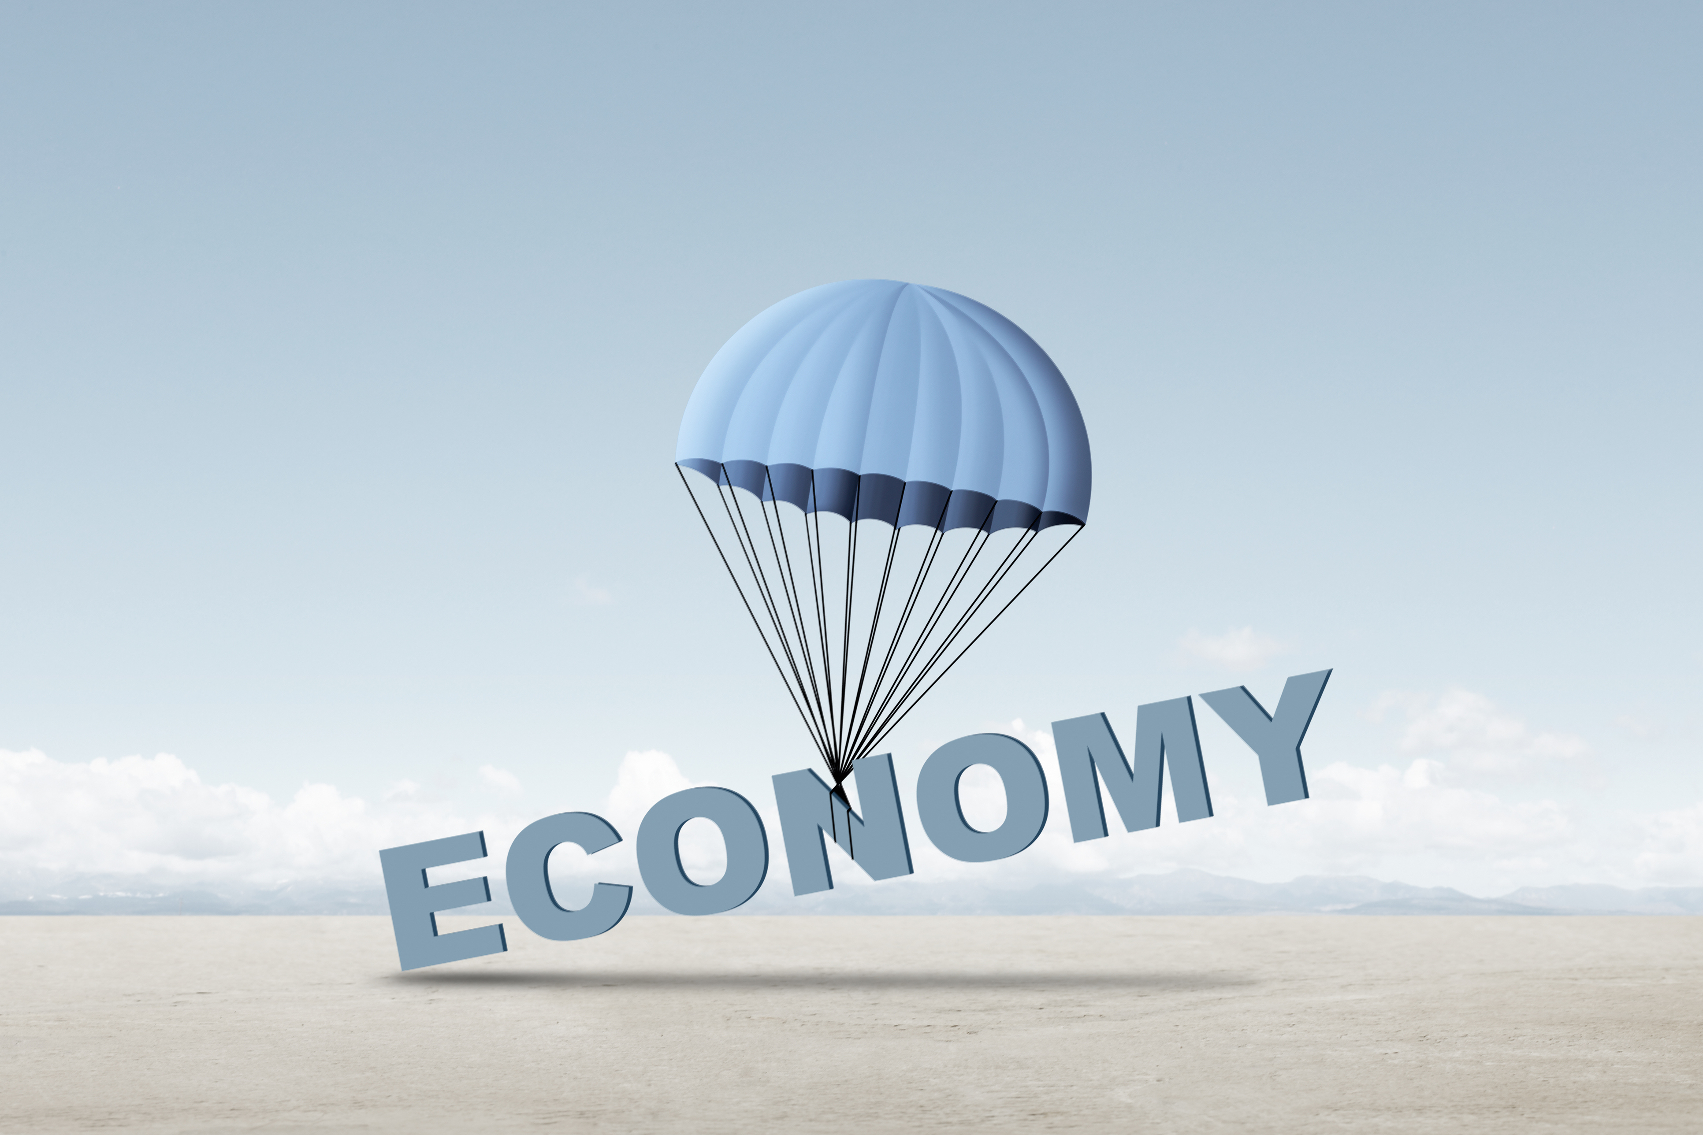
US Economy: Update
&
Changes at the Fed
Geoffrey Woglom,
Professor of Economics
Amherst College, emeritus
September 16, 2026

Slide 9
Outline for the Talk
Overview of State of the Economy: Remarkable resilience in the face of wars, oil prices & tariffs, but worrying signs.
The recent (worldwide) runup in government bond interest rates.
Major uncertainties going forward.
Overview of Fed structure, objectives and policy tools.
The Fed’s Current Policy Dilemma.
Kevin Warsh’s (the new Fed Chair) criticisms of the Fed communication strategy

Slide 10
Judging the State of the Macroeconomy
The Fed’s Definition:
Get the economy to the highest levels of output (GDP) and employment, while
Keeping inflation low and stable, or at 2%
What about the climate change; poverty, health care?

Slide 11
Gross Domestic Product: 2026Q2 = $32.5 tr
$33.4
Less Imports
-$4.6
Plus Exports
+$3.7
Equals GDP
$32.6

Slide 12
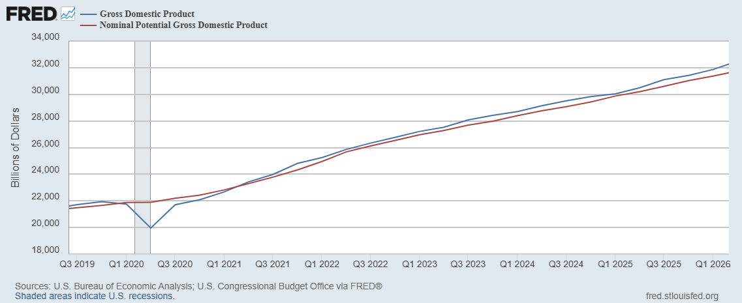
GDP and ‘Potential’ during the Recovery
Grey bar indicates recessions
Source: Fred, St Louis Fed

Slide 13
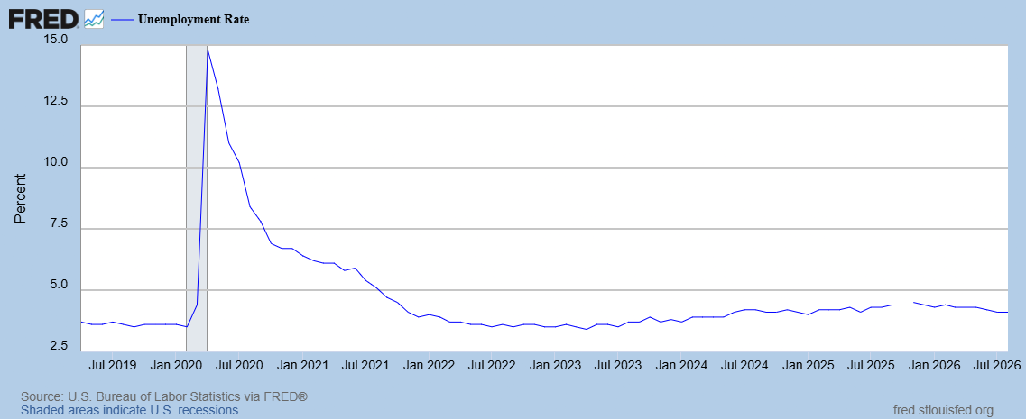
Unemployment is Near Record Lows

Slide 14
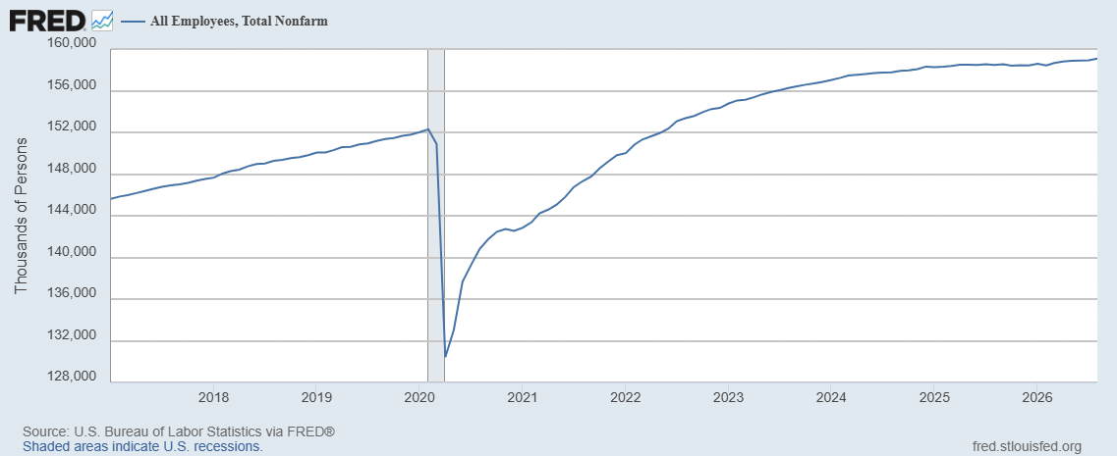
Where Have All the Workers Gone?
Aging of the Labor Force
Also, note the recent slowing in job growth.
Source: Fred, St Louis Fed

Slide 15
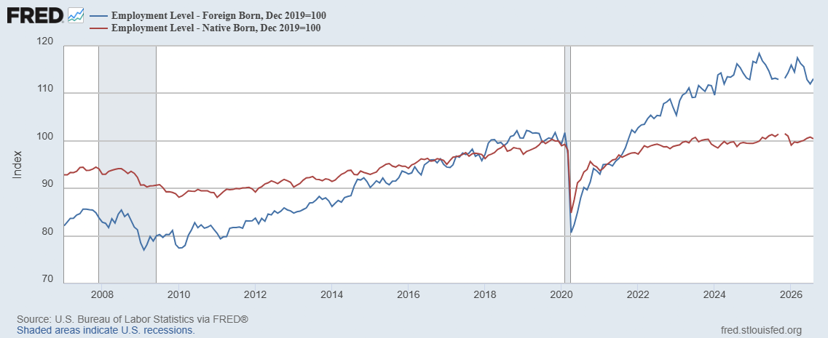
Could Have Been Worse , but for Foreign Born Workers
Between 12/19 and 4/25
NB employment flat
FB employment rose by 5000k
Since 4/25 FB employment
fell by 1600k; NB up 700k

Slide 16
BLS September Jobs Surprise
Notes:
Response rate: Precovid in the 70s, now below 30

Slide 17
The Real Side of the Economy is Still Good
GDP is very close to its potential.
The labor market as measured by the unemployment rate is fully recovered.
Macro Goal number 1, check
But what about goal number 2, the “nominal” side of the economy

Slide 18
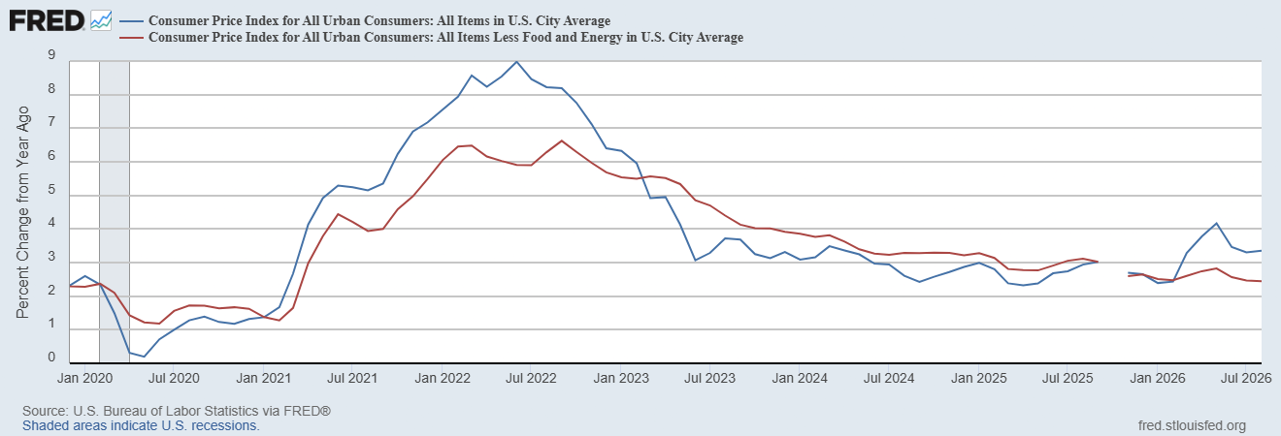
Inflation during the Recovery (CPI)
Notes:
August CPI yoy 8.3% down from 8.5 and Core 6.3 up from 6.3 in JUly

Slide 19
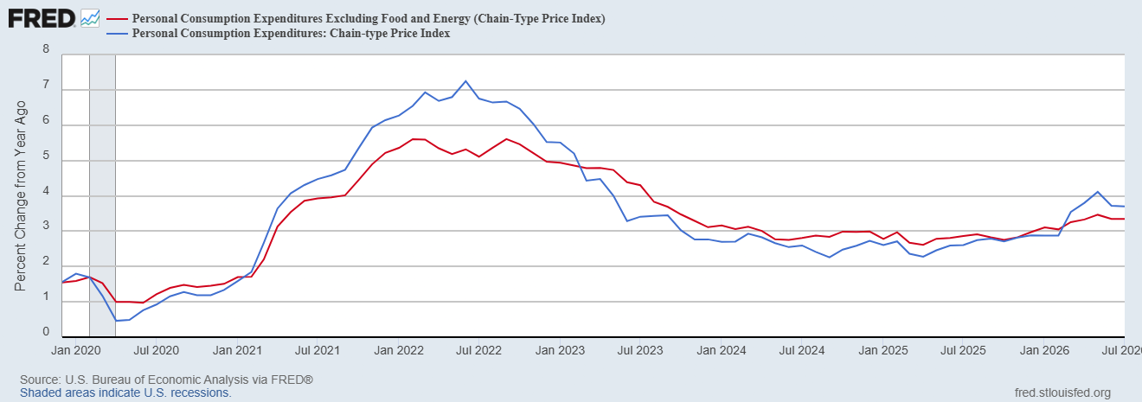
Fed’s Measure (PCE)
Inflation Accelerates 3/2021
Fed Doesn’t React until 3/2022
Progress towards the 2 % slows Spring 2024

Slide 20
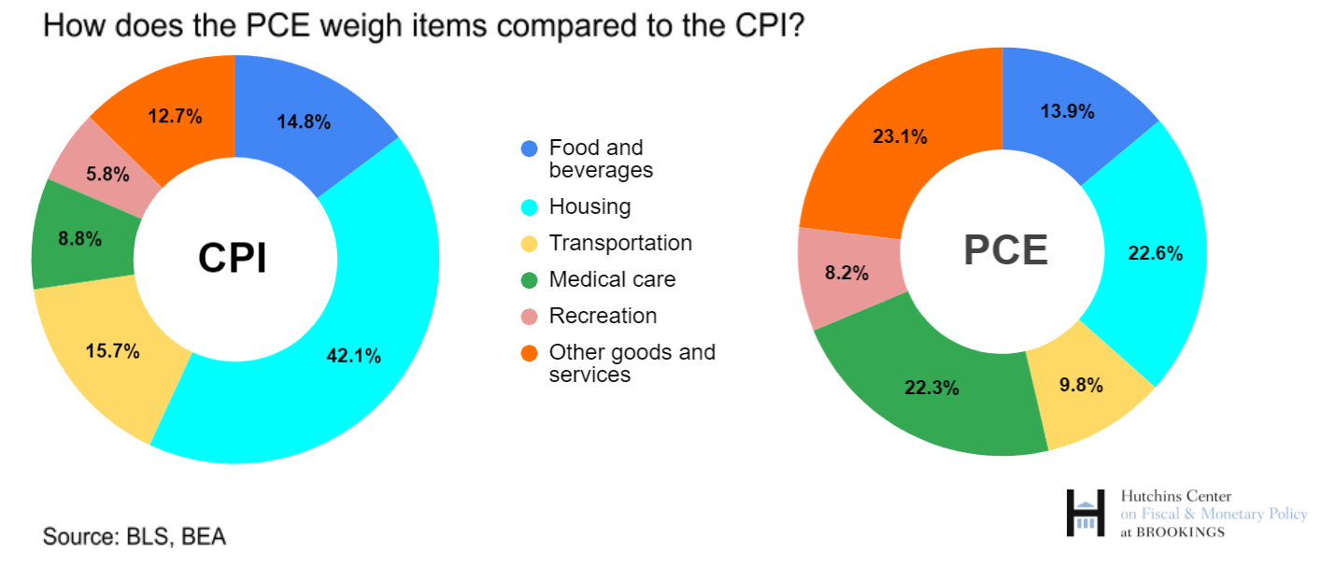
CPI vs. PCE: Differences
CPI typically tends to be 0.3 pct point higher
Jul:
CPI, 3.3%
PCE, 3.7%
Core CPI, 2.5%
Core PCE, 3.4%.
https://www.brookings.edu/articles/how-does-the-government-measure-inflation/

Slide 21
“Affordability”
Notes:
136 129 130 126 118

Slide 22
Three Measures of Cost of Housing Inflation
Notes:
87,32,30

Slide 23
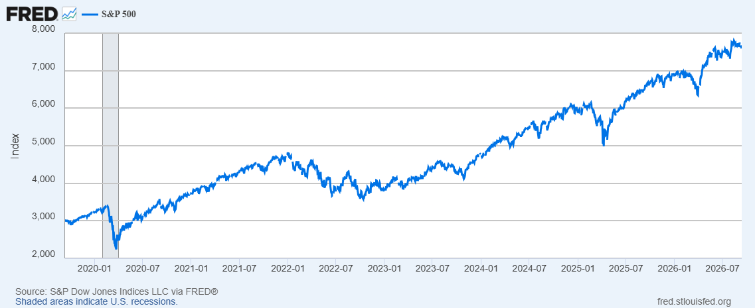
Stock Prices: Tariffs, What Tariffs; War, What War?
Notes:
Since the end of 2021, lost almost 15%

Slide 24
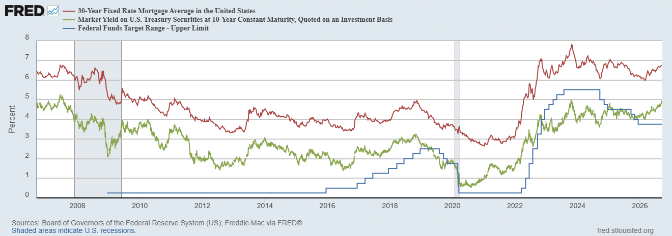
Interest Rates: Era of Falling Rates Over?
Notes:
Fed policy rate 4.5 to 4.25. Concerns with inflation

Slide 25
First Fact About Interest Rates on Bonds
The stated or nominal interest rate has two parts
  A compensation for expected inflation over the life of the bond.
  A “real” return which is higher the riskier the bond.
Comparing US Bonds to Inflation protected US Bonds (TIPs) shows the two components.

Slide 26
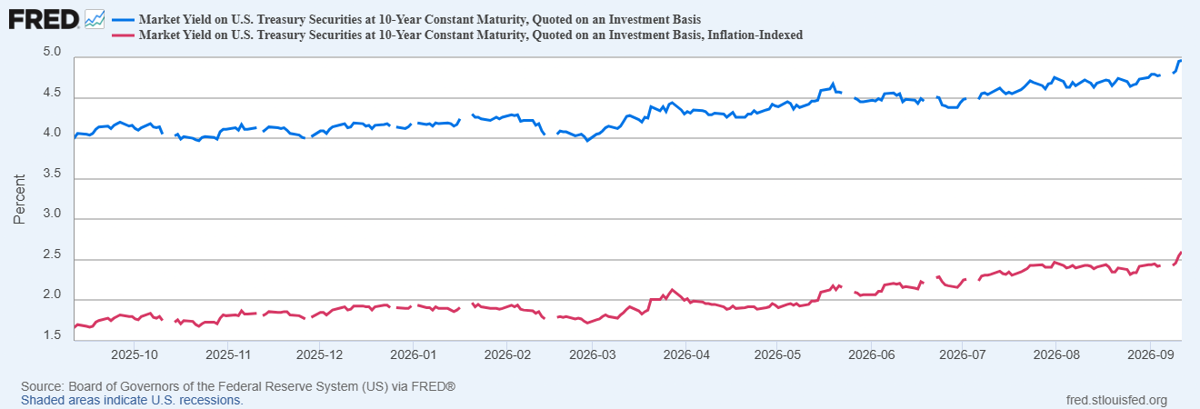
The Rise in Government Bond Interest Rates
Inflation Compensation
=4.96-2.60=
2.36%
Inflation Compensation
=4.08-1.72=
2.36%

Slide 27
Why Did the Real Interest Rate Rise?
US Government Bonds are Perceived to Be Riskier – Debt and Deficits are on an Unsustainable Path.
The Demand for Credit is Rising due to fiscal deficits and AI Investment spending.

Slide 28
Second Fact
Long-term bond rates can also be decomposed into 2 different components:
  The expected average of short-term rates over the life of the bond
  A term risk premium because the price of long-term bonds is more volatile. than short term.

Slide 29
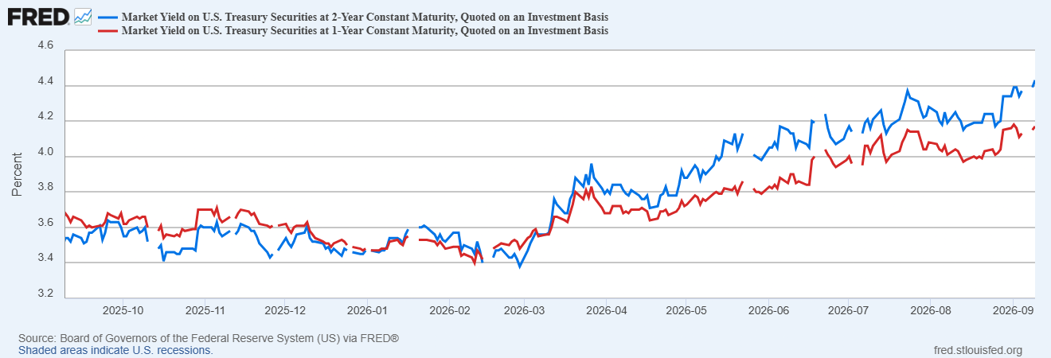
An Example: Interest Rates on 1 &2-yr Bonds
Why has the 2-yr rate risen above the 1-yr rate?
Why would anyone buy a 2-yr bond paying 3.54%, when they could buy a 1-yr bond paying 3.68%

Slide 30
Putting it All Together
The Interest rate on long-term bonds depends on:
The real short-term rate.
Expected inflation.
The expected path of future short-term rates.
Risk premiums.
Why Bother?
Because the long-term interest rates (e.g., mortgage rates) have the most influence on aggregate demand by affecting house buying, business investment and stock prices. (Also, have major implications for fiscal sustainability)
Note the importance of expected future inflation and the path of short-terms rates

Slide 31
The State of the Economy & the Future
The key indicators for judging the macro economy are still good
  Output and unemployment are close to their “full employment” levels, although the labor market data may be getting worse
  Inflation is still elevated, but some of this is due to “price shocks.”
Concerns
  Growth in demand could be weakening.
  AI bubble bursts?
  Price shocks may get worse due to war in Iran.
Major Uncertainty: the Future of the Fed & Monetary Policy

Slide 32
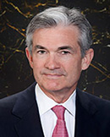
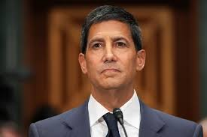
Stabilizer in Chief: the Fed
The Fed’s Dual Mandate:
  “Stable prices” which means 2% rate of inflation in the Personal Consumption Price Index (which corresponds to about 2.5% inflation in the more well-known CPI).
  “Maximum employment” which means the highest level of employment (lowest unemployment rate) consistent with mandate 1.
Monetary policy is made by the Federal Open Market Committee (FOMC), comprised of the 7 Fed Governors and 5 of the 12 Presidents of the Regional Federal Reserve Banks on a rotating basis.
The FOMC has scheduled meetings 8 times a year, but can hold unscheduled meetings at a moments notice (e.g., March of 2020)
Jerome Powell
February 2018
Kevin Warsh
May 2026
Notes:
Define inflation as the rate of increase in the average level of prices not gasoline price inflation. Exceptions Deep Recesssions. ARP we will talk about later.

Slide 33
The Transition
Governors are appointed for 14-terms.
One governor is nominated by the President to serve a 4-year term as Chair.
Jerome Powell’s term as Chair expired, but his term as a governor extends to January 31, 2028.
Historical precedent, Marriner Eccles 1948-1951 at Harry Truman’s request.
Fun Fact: neither Eccles (high school dropout/banker), Powell (lawyer/banker) nor Walsh (lawyer/banker) were PhD economists.

Slide 34
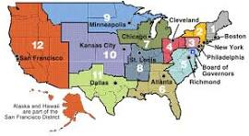
The Rest of the Team: Federal Reserve Banks
Manage the payments system (check clearing)
Day-to-day supervision and monitoring of member banks.
Consumer and community affairs.
All Bank Presidents participate at FOMC meetings, but only 5 vote.
Reserve Banks have a Board of Directors: 3 appointed by the Board; 6 appointed by member banks (3 to represent banks; 3 to represent the public).
Public and Board Directors appoint president subject to Board approval for a 5-year term.

Slide 35
The Fed’s (and consensus) View of Inflation
Three Determinants:
Inertia caused by expectations of inflation that get built into normal wage and price increases.
The balance of aggregate demand for total goods and services (AD) and aggregate supply (AS)
  AD>AS inflation rises above expected inflation.
  AD<AS inflation falls below expected inflation.
Price Shocks unrelated to 1) &2) temporarily affect inflation
  Negative shocks, e.g., tariffs, Mideast war, supply chain disruptions.
  Positive, e.g., unusual productivity increases that lower prices; AI (?)

Slide 36
Fed Policy Tools
Interest Rates: Higher interest rates lowers AD, and vice versa.
  Sets a ¼ percentage point target range for a short-term interest rate, the federal fund rate, overnight loans between banks. (Currently, 3.50-3.75%).
  Influences long-term interest rates via “Quantitative Easing” direct purchase of long-term government bonds and mortgage-backed securities (MBS).
“Credibility:” public confidence that the Fed will achieve its objectives leading to “well anchored inflationary expectations”.
  Communication & Transparency
  Central Bank Political Independence.
Note that the Fed cannot directly affect AS, or price shocks

Slide 37
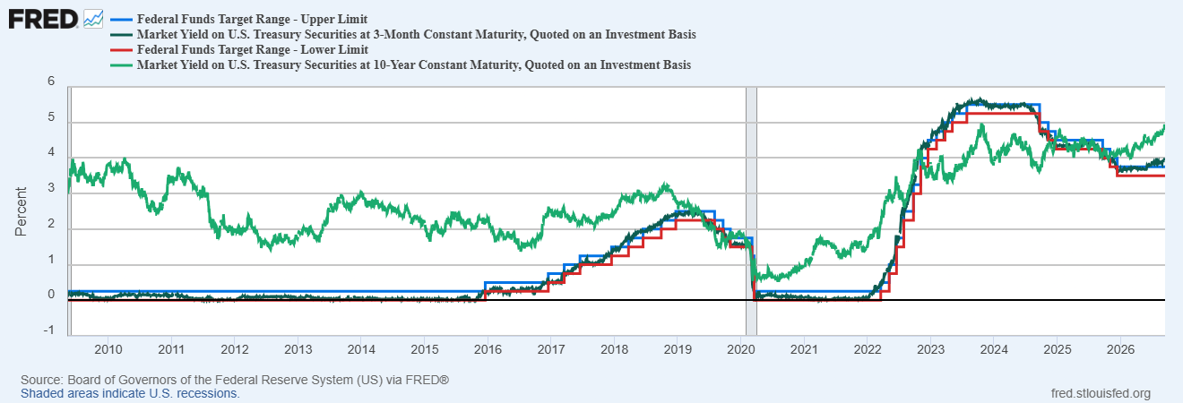
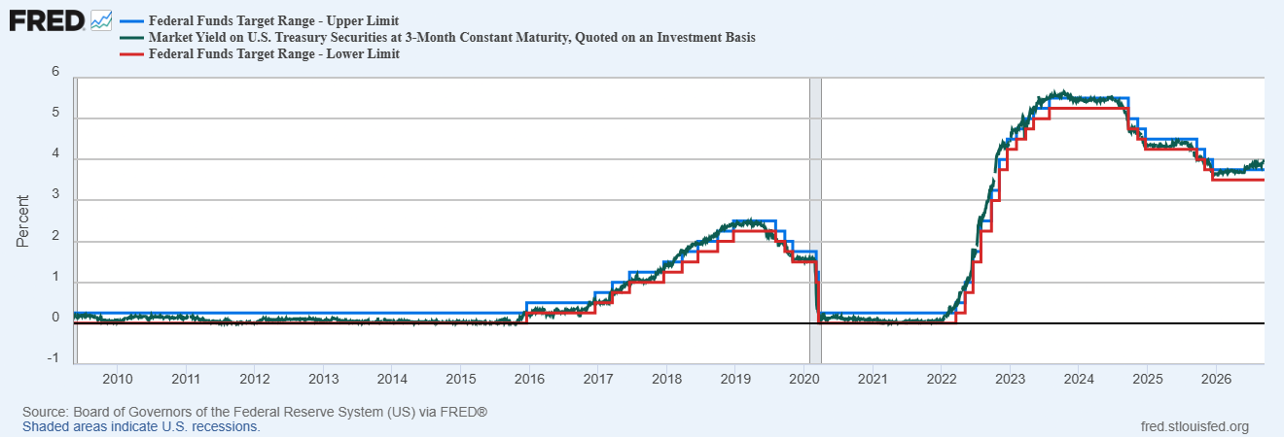
Primary Monetary Policy Tool

Slide 38
Central Bank Independence
Monetary Policy interest rate decisions are made by the Fed (FOMC) and cannot be reversed by other branches of government.
Federal Reserve Governors have 14-year terms.
The Fed’s expenses are financed from operations; it doesn’t have to go to Congress for appropriation
The Fed is accountable to Congress and the public by:
  Congress Sets the “Dual Mandate” (but not numerical targets).
  Chair testifies to Congress.
  Policy Statement issued and Chair Press Conference after Policy meeting
  Current Policy deliberations are made available with a 6-week lag.
  All policy discussions are released with a 5-year lag.

Slide 39
Central Bank Independence in a Democracy
The argument for independence is based on the view (supported by evidence) that monetary policy driven by democratic politics delivers higher average inflation with no effect on average unemployment.
Squaring the circle:
  Political accountability.
  The Fed should “stay” in its lane. Ignore all issues other that monetary policy and financial stability.

Slide 40
The Feds dilemma
Price shocks (tariffs, war-related increases in oil prices) increase inflation
To combat rising inflation the Fed needs to raise interest rates to lower demand and spending.
To combat rising unemployment the Fed needs to lower interest rates to increase demand and spending
In navigating the path between the two problems it is crucial not to:
  Allow temporary inflation to feed into inflationary expectations (Note credibility makes this easier to accomplish).
  Cause a recession by raising interest rates too far, too fast.
Powell’s Post 2023 success was “steering” correctly: reduction in inflation with no recession.

Slide 41
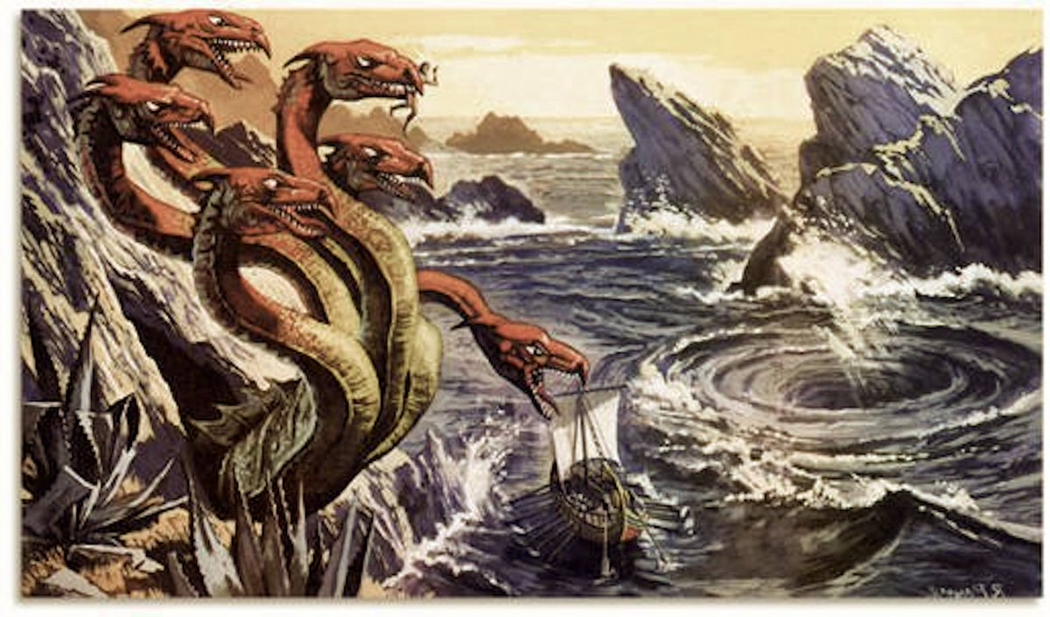
Scylla and Charybdis: “A Rock and a Hard Place”
Inflation
Jerome Powell
Recession

Slide 42
Kevin Warsh’s Criticisms
2021-2022: “…greatest mistake in macroeconomic policy in 45 years,”
QE should not have become a permanent feature of the economy.
“Mission Creep” threatens political independence.
Fed is ignoring the disinflationary effects of AI increasing aggregate supply.
Too much “forward guidance,” particularly the “dot plot.”

Slide 43
Forward Guidance: Communication Strategy
Pre 1993: “Omerta”
1993: Minutes of FOMC meeting published with a month’s delay
1994: Policy Statement is released announcing what the Fed had done to the target federal funds rate the last day of each FOMC meeting.

Slide 44
Bernanke Reforms: “Radical Transparency”
2007: Summary of Economic Projections: FOMC members forecasts of major macroeconomic variables including the federal funds rate 4 times a year.
2011: Chair hosts a press conference immediately after the FOMC meeting
2012: Fed issues annually “Statement of Longer-Run Goals and Monetary Strategy,” (First explicit statement of the 2 percent PCE inflation target)
2012: Introduces the infamous “dot plot.”

Slide 45
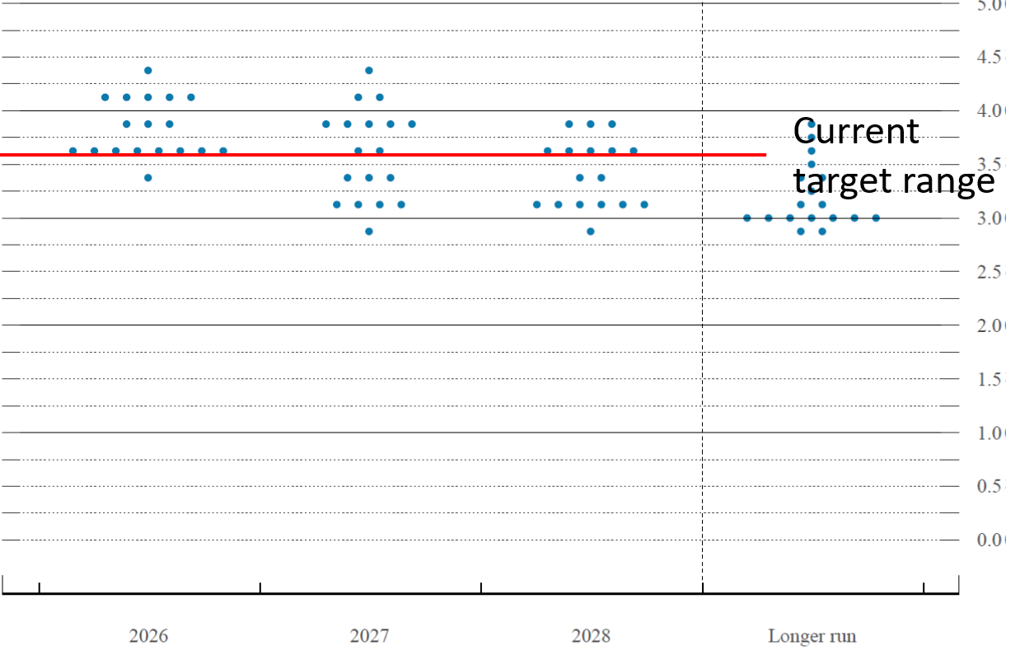
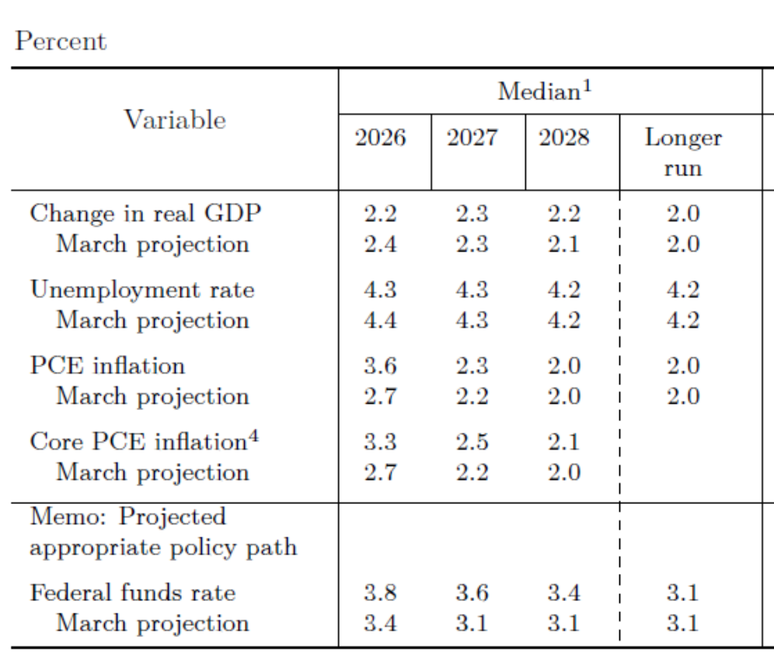
Summary of Projections & Dot Plot (June 2026)
FOMC member’s (except Warsh’s) forecast of the federal funds rate at the end of the year.
4.5
3.0

Slide 46
What is the purpose of this information?
Remember the Fed needs to affect long-run interest rates which depend on expected inflation and the expectation of the path of short-term interest rates.
Transparency helps to increase credibility thereby stabilizing inflationary expectations.
This “forward guidance” on future federal fund rates can influence longer-term rates, which have a bigger influence on aggregate demand.
Ben Bernanke (https://www.brookings.edu/articles/inaugurating-a-new-blog/):
When I was at the Federal Reserve, I occasionally observed that monetary policy is 98 percent talk and only two percent action.

Slide 47
The Ultimate in Forward Guidance
1/28/2009 Policy Statement:
The Federal Open Market Committee decided today to keep its target range for the federal funds rate at 0 to 1/4 percent. The Committee continues to anticipate that economic conditions are likely to warrant exceptionally low levels of the federal funds rate for some time.
Warsh voted for the statement and does not object to forward guidance in emergencies.

Slide 48
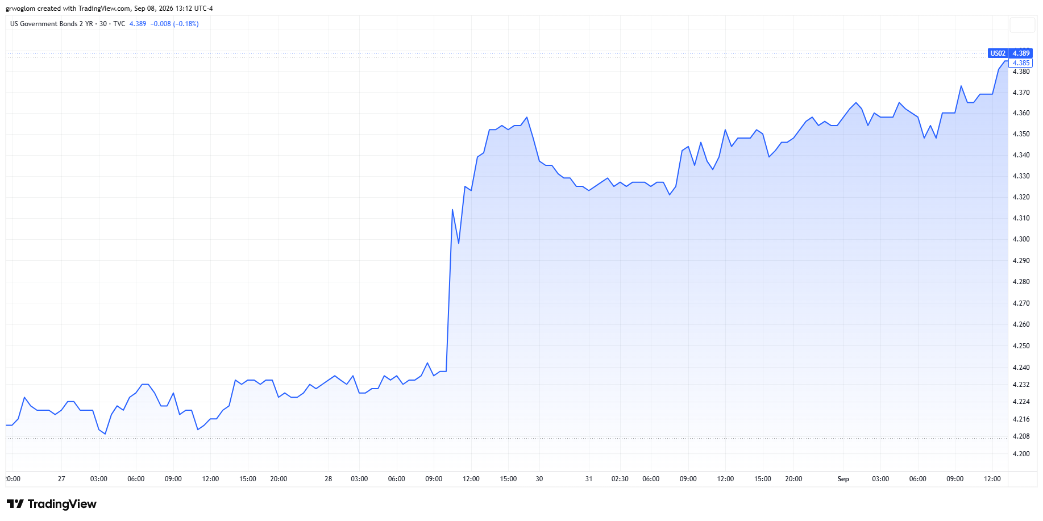
Kevin Warsh Keynote Address at Jackson’s Hole
Warsh started speaking at 10AM and ended shortly after 10:30.

Slide 49
Warsh’s Criticism of Forward Guidance
Does the FOMC forecast of the funds rate interfere with needed corrections to policy: “And I believe when policymakers make quasi-commitments on interest rates through the cycle, we inhibit our own freedom to make the right calls when it's time to decide.”
Do Fed forecasts distort market signals: “To get policy right, we also need to get the relationship right between financial markets and the central bank. The Fed needs clear market signals, as unfiltered as possible . . . from market internals . . . the level and change in asset prices across sectors . . . the prices and trading volumes of Treasury securities.

Slide 50
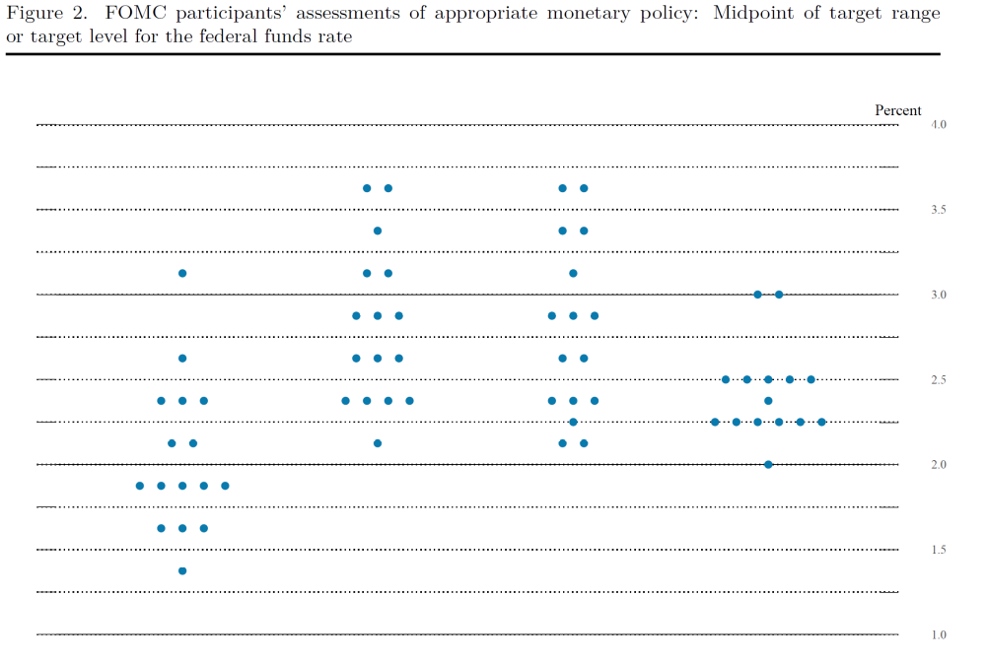
Infamous Dot Plot of March 16, 2022
The actual March 2022 funds rate was 0.25-0.5
The “market implied” expected federal funds rate for December was 1.75 percent.
3.0
2.0
The actual Dec fed funds rate was 4.25-4.5

Slide 51
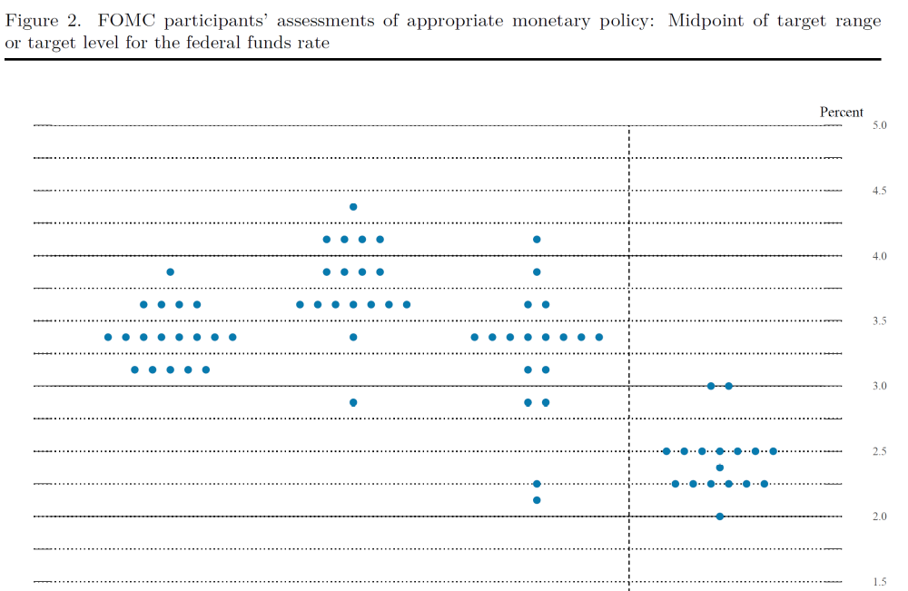
Next Dot Plot, 6/15/2022
The June federal funds rate was 1.5-1.75
Did the Fed “hold on to March forecasts” too long?
4.0
3.0
Was the market misled in March?

Slide 52
Can There be Too Much Talk?
During any given month Federal Reserve Bank Presidents and Governors give about 3 speeches and interviews on average.
In these speeches they will typically opine on inflation and unemployment.
Should the Fed be speaking so frequently with so many different voices?

Slide 53
So, Will Monetary Policy Be Different
Maybe, remember there are 12 voting members of the FOMC and President Trump only appointed 3 Governors.
Kevin Warsh,
“We should have a big, robust deliberation inside the FOMC,” Warsh said during questioning from Sen. Cynthia Lummis. “I tend to favor messier meetings than some, where people don’t show up with rehearsed scripts, but we can have a good family fight.”“If the central bank has that good family fight, I think they’re going to make better decisions,” Warsh added. “And if they happen to make mistakes, they’ll correct them sooner.”
https://finance.yahoo.com/economy/policy/article/kevin-warsh-testifies-he-never-made-a-deal-with-trump-to-lower-interest-rates-as-fed-chair-183701077.html

Slide 54
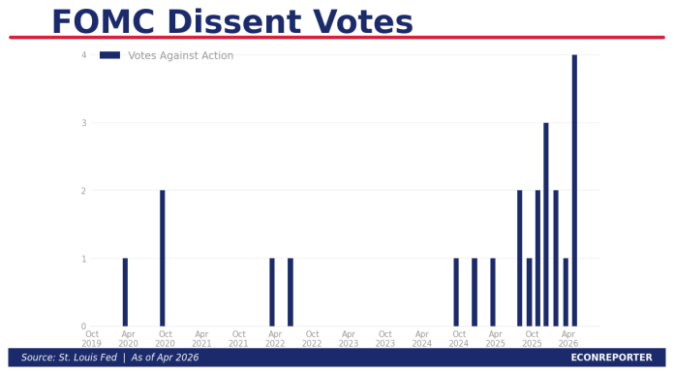
Careful What You Wish For
I don’t know if this is a good sign or bad. What do you think?
But, we will see if Warsh gets his wish starting now!

Slide 55
Today’s Policy Statement
https://www.federalreserve.gov/

Slide 56
My Google Site
https://sites.google.com/view/macro-current-issues/economic-update

Slide 57
Let’s Hear from You!
Geoffrey Woglom grwoglom@amherst.edu
Contact NEED: Info@NEEDEcon.org
Support NEED: www.NEEDEcon.org/donate.php

